Slide 1

Java OOP
Hotel Management System
This presentation covers the design and implementation of a Java-based Hotel Management System developed for the CSE231 Spring 2025 project. The system uses object-oriented programming principles to manage hotel bookings, room allocation, and guest information efficiently.
We will explore the class hierarchy, key features, and how inheritance, encapsulation, abstraction, and polymorphism are applied throughout the system.
By Tadros Karam Kamel ID:2100425

Slide 2
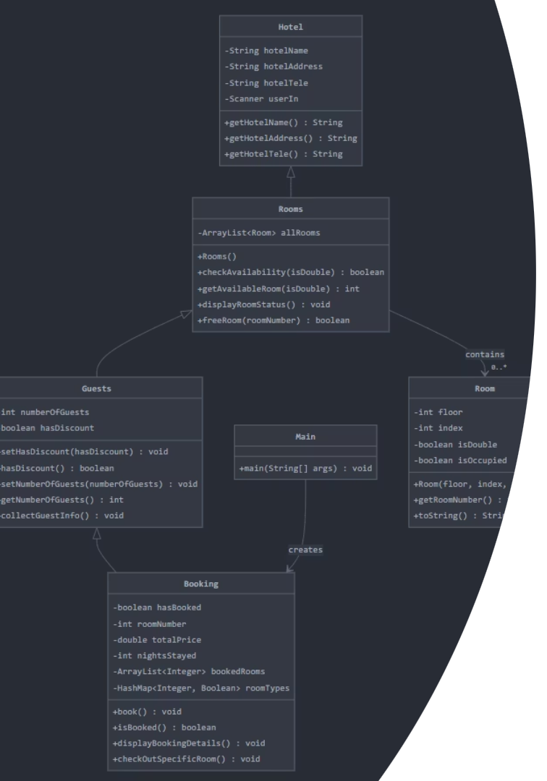
Project Overview and Class Hierarchy
Abstract Hotel Class
Rooms Class
Base class containing hotel information like name, address, and phone number. Serves as foundation for other classes.
Manages room availability and stores a collection of rooms, extending Hotel.
Guests and Booking Classes
Guests class handles guest data; Booking class manages the booking process, both extending from Guests → Rooms → Hotel

Slide 3
Hotel Class: Foundation of the System
Static Hotel Properties
Information Access
Abstract Base
Stores hotel name ("Grand"), address, and phone number as static fields.
Provides getter methods to retrieve hotel details and a displayInfo() method to show formatted information.
Acts as an abstract class to be extended by other system components.

Slide 4




Room Class: Representing Individual Rooms
Room Properties
Includes floor number, room index, room type (single/double), and occupancy status.
Unique Room Number
Generates room numbers based on floor and position, e.g., 101, 202.
Room Status
Tracks availability and occupancy, with a toString() method for readable display.

Slide 5

Rooms Class: Managing Room Collections
Room Creation
Room Management
Creates 27 rooms across 9 floors, alternating single and double rooms.
Check availability by room type
Assign and mark rooms as occupied
Sort rooms by number
Free rooms upon checkout

Slide 6
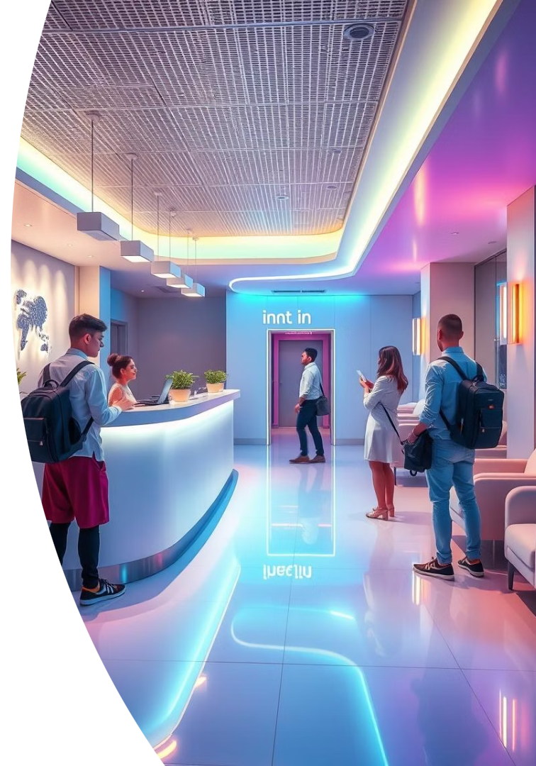
Guests Class: Handling Guest Information
Guest Tracking
Discount Management
Maintains number of guests with validation between 1 and 9.
Tracks if guests have discount coupons to apply during booking.
User Input
Collects guest information

Slide 7
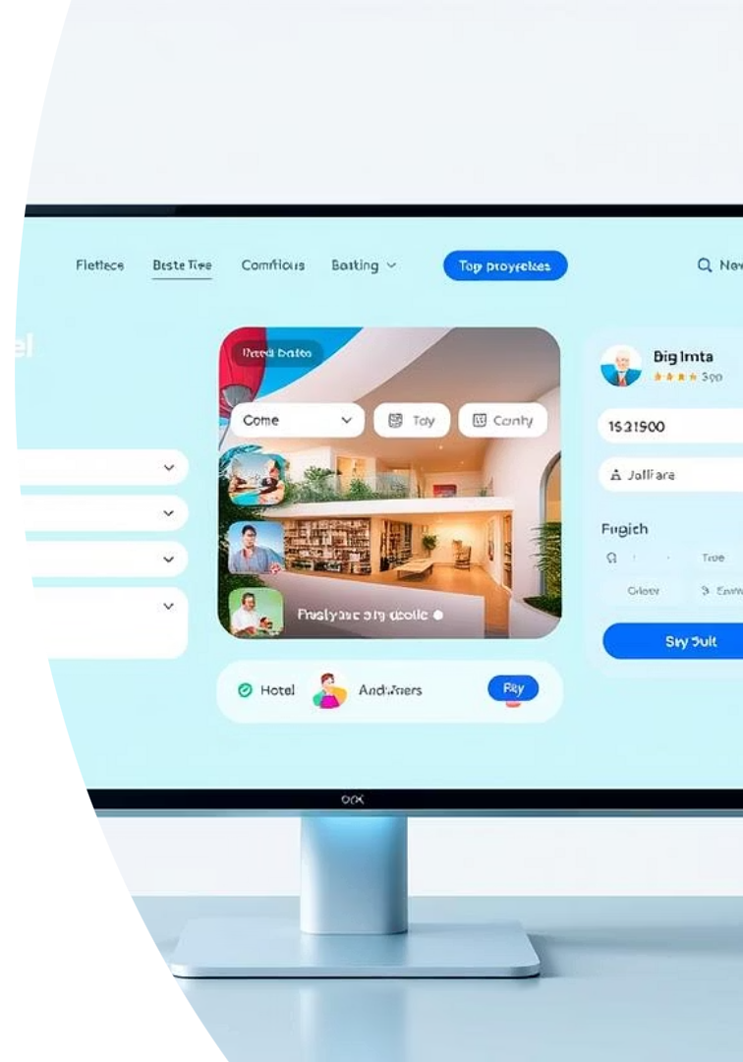
Booking Class
Booking Workflow
Price Calculation
Manages room assignments, tracks booked rooms, room types, total price, and nights stayed.
Calculates prices based on room type and applies discounts when applicable.
Guest Interaction
Allows guests to confirm bookings, view details, and check out from specific rooms.

Slide 8
Main Class: Execution of all
Menu Options [Using a while loop & switch case]
Make bookings
View booking details
Check room status
Exit application with farewell message

Slide 9

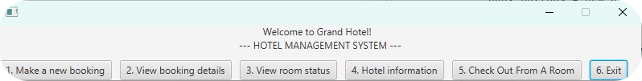
UI

Slide 10

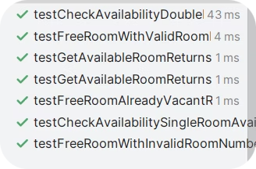
Bonus: JUnit Testing
Testing Rooms class

